Slide 1
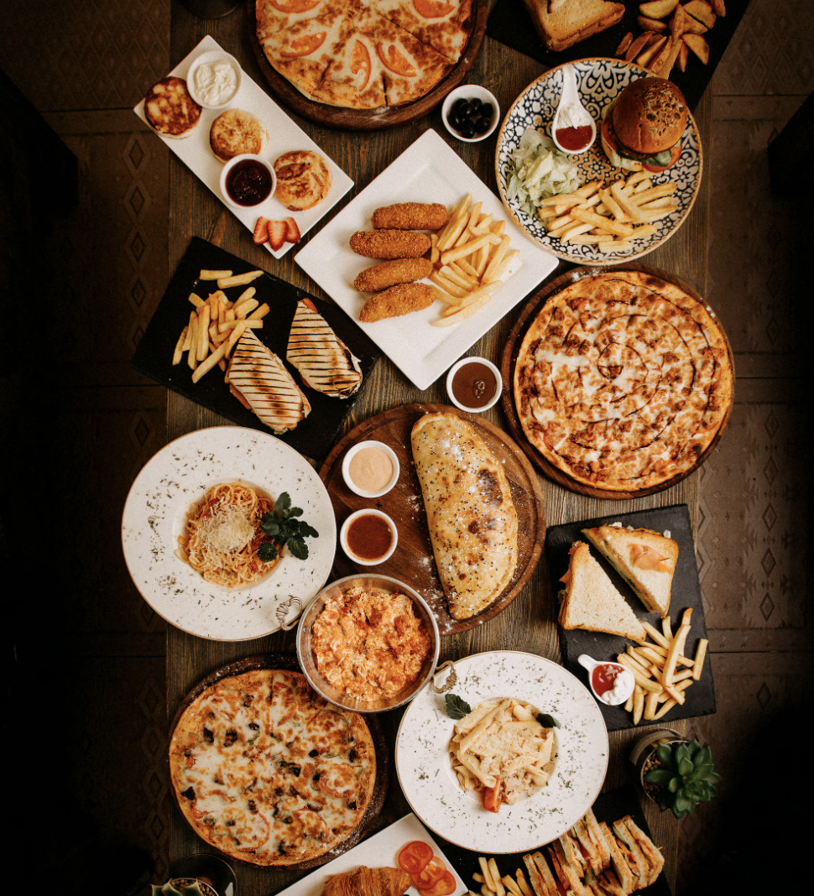
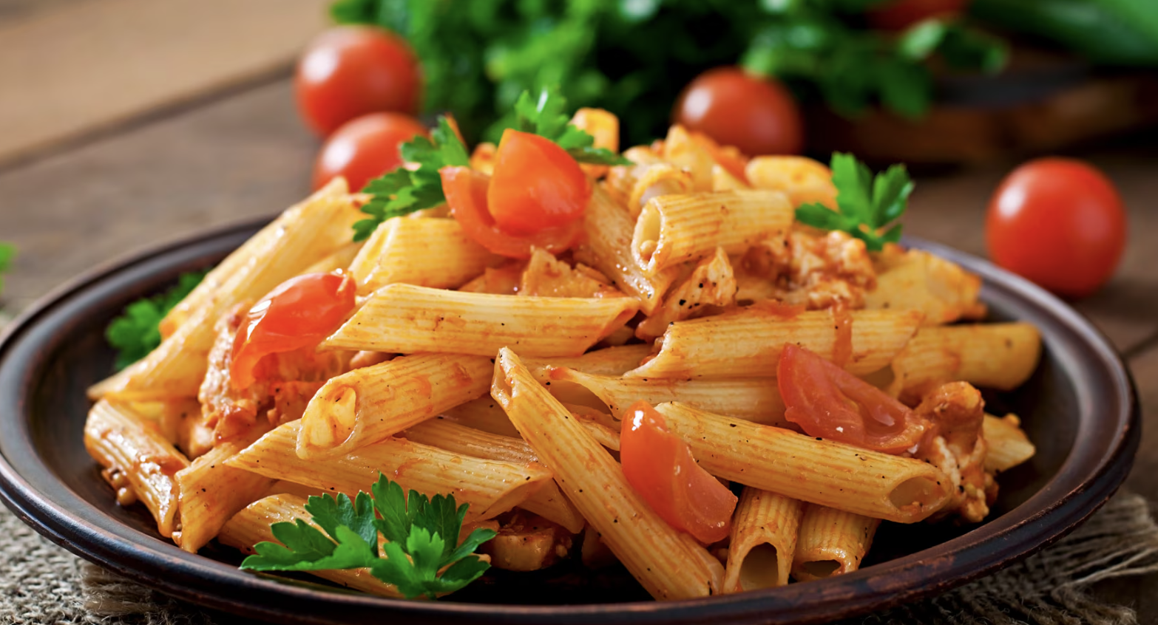
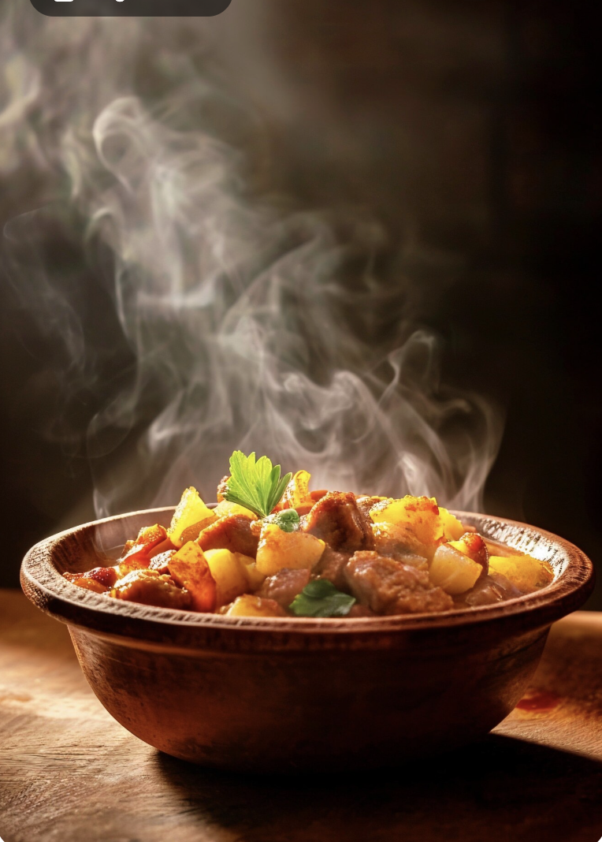




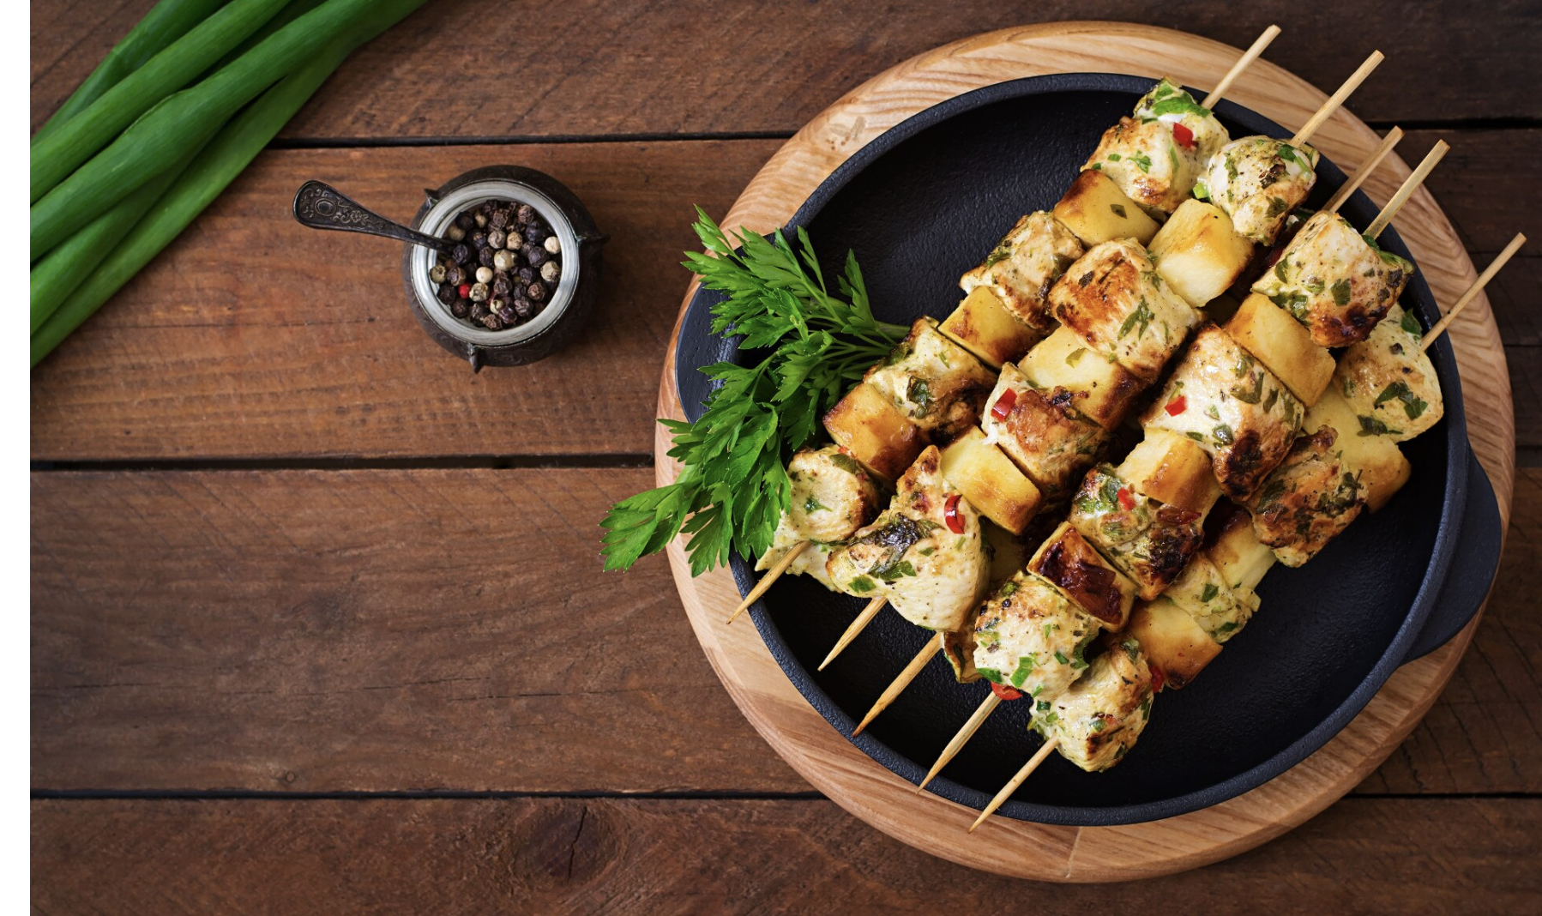

Zomato Restaurants Expansion
Author: Angel Joy

Slide 2
About Zomato
2008
Founded as Foodiebay by Deepinder Goyal and Pankaj Chaddah
2010
Rebranded as Zomato
2015
Launched online food ordering and delivery in India
2018
Crossed $1 billion
valuation
2022
Acquires Blinkit
2023
Parent company renamed to Eternal

Slide 3
Data Problem
Zomato aims to identify the most promising locations to open new restaurants with low competition and maximum growth potential.
Key Objectives:
Analyze restaurant distribution across the countries to identify the markets.
Evaluate customer demand through ratings, engagement (votes) and pricing.
Identify high-performing cuisines and its features (online delivery/booking).

Slide 4
Data Snapshot
Data Cleaning and Preprocessing
Checked duplicates
Trimmed 170 white-spaces
Handled missing values in the "Cuisines" category and trimmed excess white spaces.
Converted all costs to INR and corrected city names
Total number of Restaurants : 9552
Countries analyzed : 15
Votes and Rating datas are key to calculate the demand of the restaurants
This data is crucial to highlight the hotspots for the new restaurants and the high-rated cuisines that can be served.

Slide 5

Analytical Approach and Tools
Data Cleaning : Removed duplicated, Trimmed 170 white-spaces, haddled 9 missing values using count blanks
Data Enhancement: Updated country name using VLOOKUP, updated average cost of cuisine and used SORTN & UNIQUE for sorting top 10 cuisine & restaurants.
Descriptive Analysis: Created Pivot Table to summarise the data
Trend Analysis : Created Charts visualizations to analyzing the trends
Customer Segmentation: Applied SORT and Filter to category data based on the votes and rating.

Slide 6
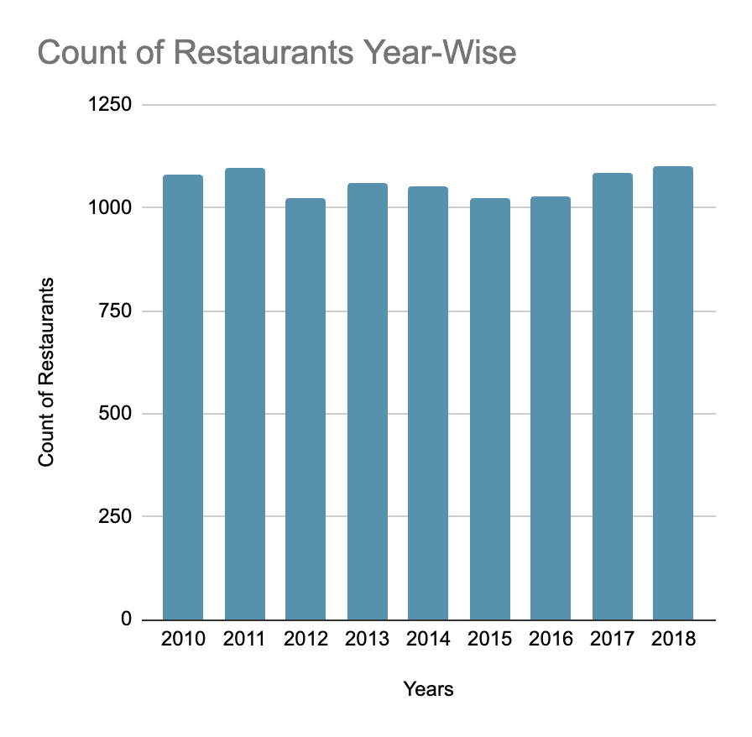
Restaurants Expansion Across the Years
Steady growth in restaurants across the years.
More than 1000+ restaurants are opened each year.
Consistent Expansion points to an opportunity in the restaurant market.

Slide 7
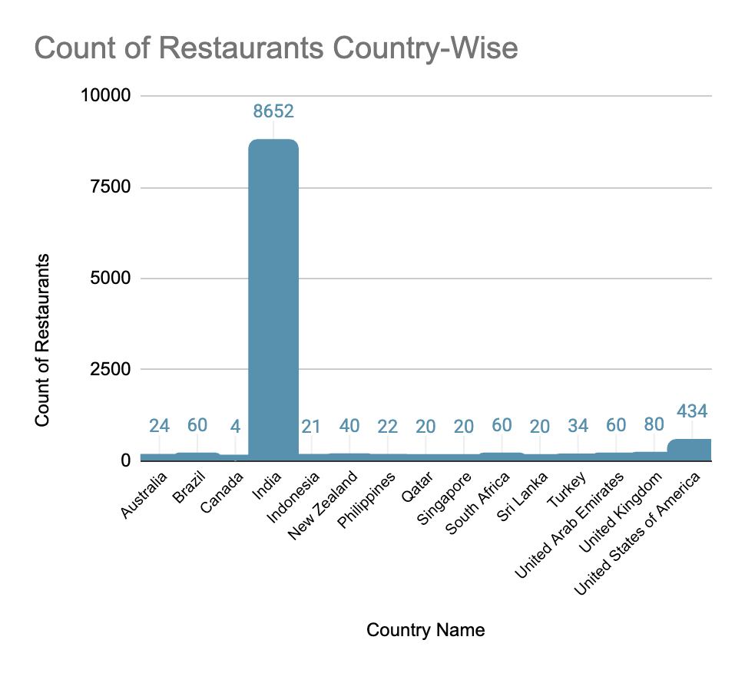
Restaurants Distribution Across the World
Restaurant counts were analysed global level to find the density of competition.
India has the highest count (8652) of restaurants in the world ie. 90.6% (high competition)
Philippines has only 22 restaurants and Indonesia with 21 restaurants.
Opportunity lies in low competitive regions.

Slide 8
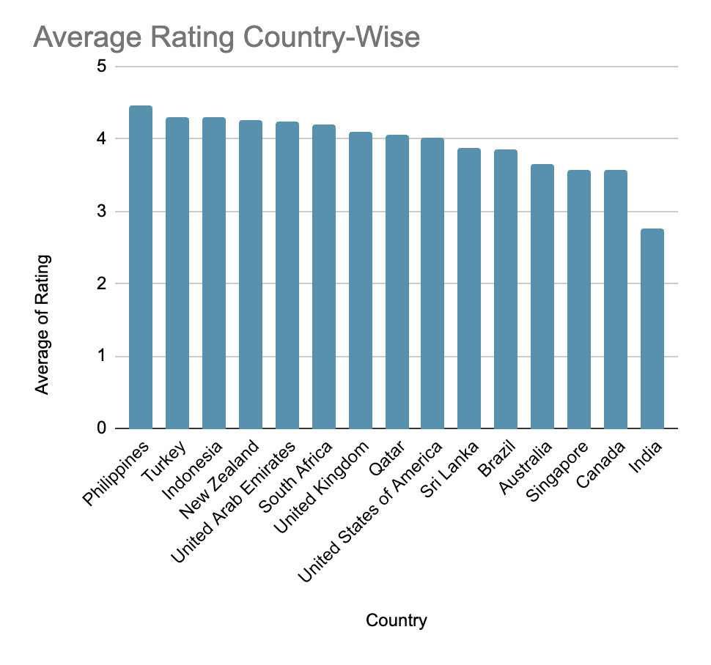
Ideal Countries based on Rating
Philippines, Indonesia, Turkey, Sri Lanka, Qatar, Australia and Canada are best considering their high rating.
Philippines with highest rating (4.47).
Indonesia: With only 21 restaurants, it has a very high rating (4.30) and the highest customer engagement
Turkey: Shows strong potential with 34 restaurants, a high Average Rating (4.30), and strong engagement .
High ratings in these regions indicate a customer base that values quality and is highly engaged.

Slide 9
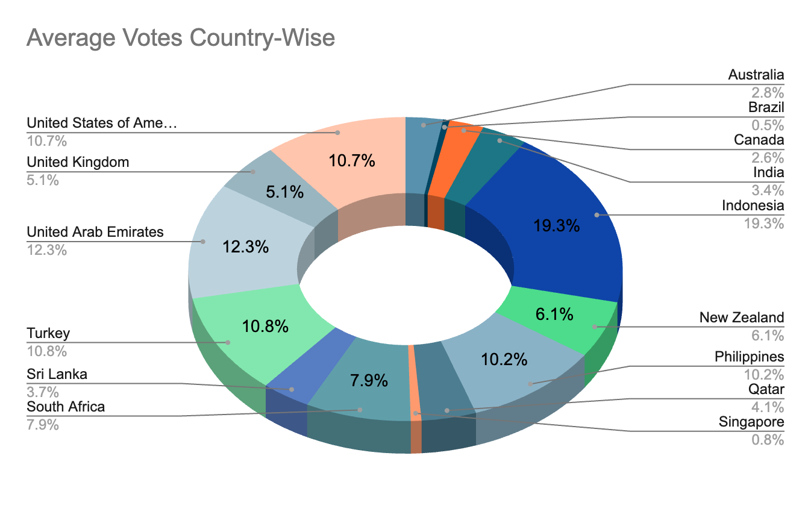
Ideal Countries based on Votes
Indonesia, Philippines, UAE, Qatar, USA and Turkey are the countries holds major share in vote distribution.
Indonesia holds the largest share by 19.3%, depicting high engagement.
Though, India has the highest number of restaurants, vote percentage is very low (3.4%) indicating poor demand.

Slide 10
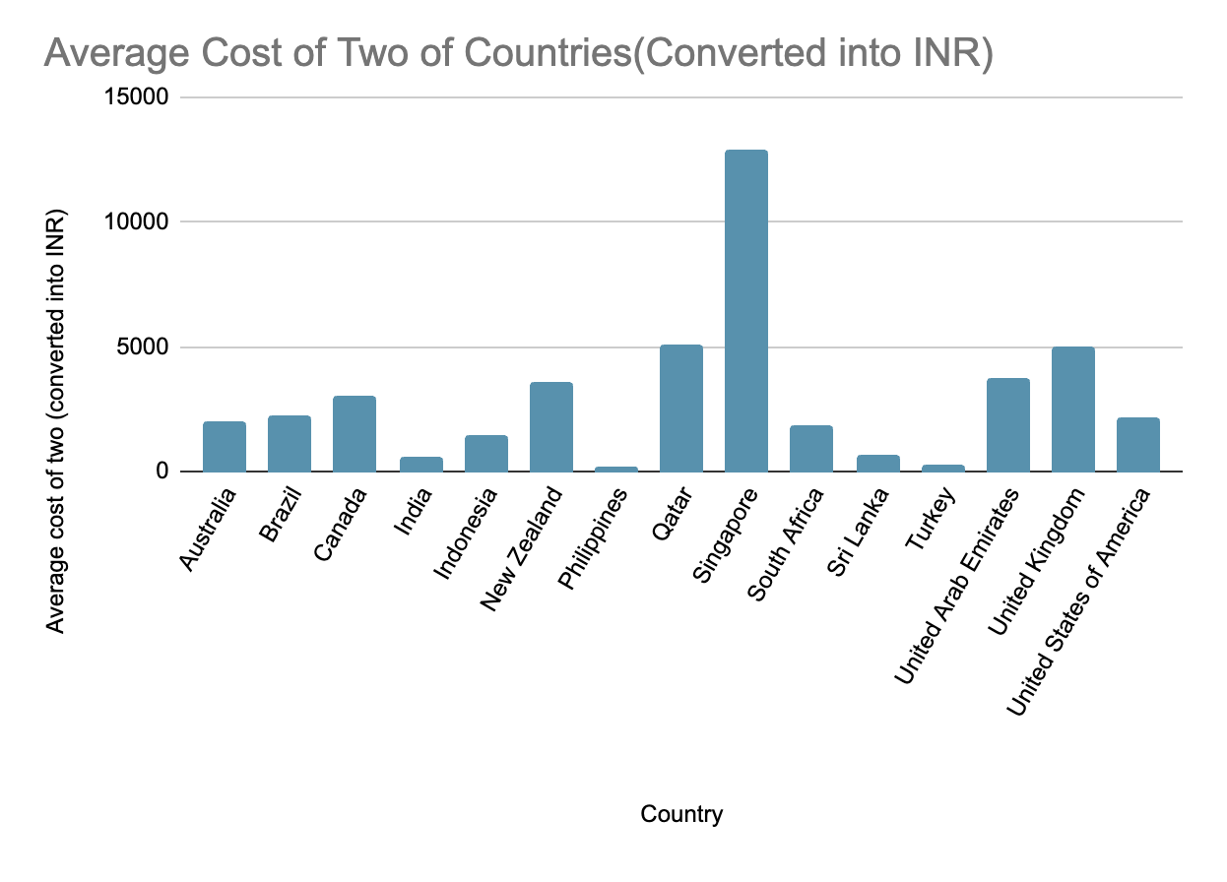
Financial Expenditure Analysis
Low-Cost Markets: Turkey, Philippines, and Sri Lanka offer the lowest food expenditure, ideal for mass-market expansion.
Premium Markets: Canada and Qatar are high-expenditure zones, suitable for premium, high-budget restaurant concepts.
Optimal Pricing: Most successful cities fall within the price range bracket of 2-3

Slide 11
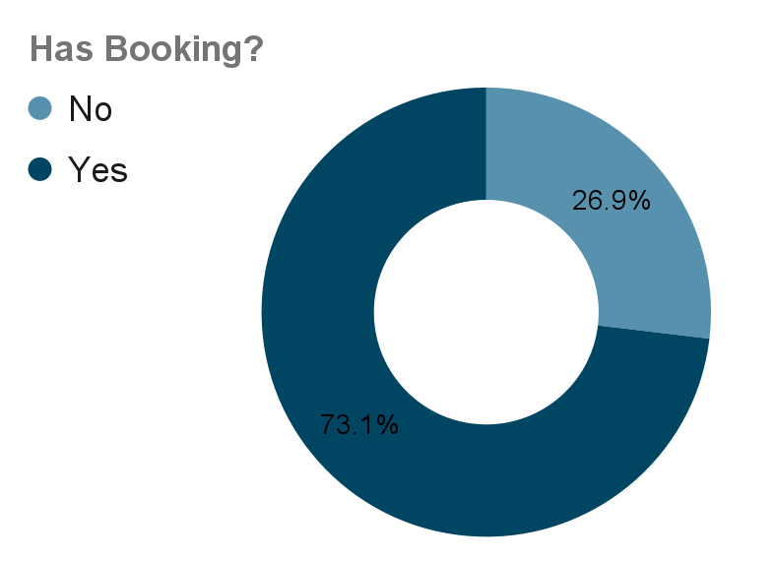
Demand for Table Booking
Data shows huge demand for Table Booking across world
73.1% of votes prefer table booking
But most of the restaurants does not have table booking, which is a opportunity

Slide 12
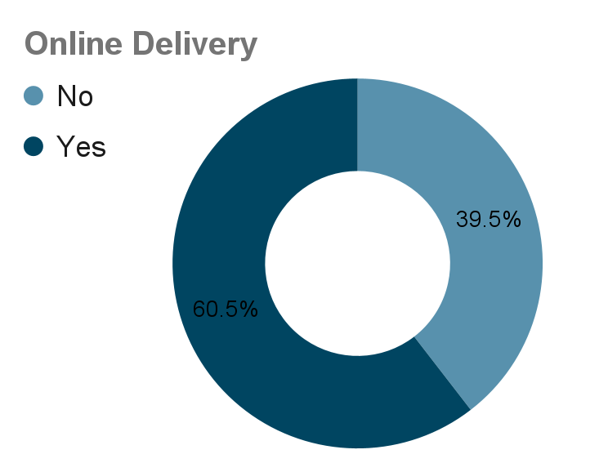
Demand for Online Delivery
Data shows the interest of customers for online delivery
Majority of the voters prefer online delivery
However, only few countries has online delivery, ie an opportunity

Slide 13
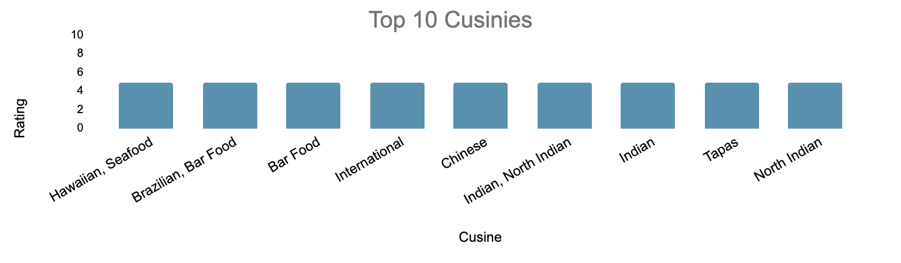
Cuisines Trends
Cuisine preference is country-dependent and not a major driver of ratings.
Recommended top cuisines include Hawaiian, Seafood, Brazilian, International, Chinese, North Indian, and Tapas.
Japanese cuisine (especially sushi) performs strongly in Asia, with ratings up to 4.9 in the Philippines and Indonesia.
Indonesian cuisine shows mixed ratings (4.9 and 3.7), indicating variability within the same category.

Slide 14
Cuisine Correlation:
The correlation between cuisine price and ratings is positive (0.31), indicating that higher-priced items tend to receive slightly higher ratings.
While price may have some influence, ratings are also significantly affected by other factors such as food quality, portion size, cuisine type, and service experience.
Therefore, increasing prices alone is unlikely to improve customer feedback unless it is accompanied by improvements in overall value.

Slide 15

Strategic Recommendations
Prefer Locality with low competition:
The Philippines, Indonesia, and Turkey are the most viable countries for expansion
Locating place where less number of restaurants, which reduces the competition
High voting and rating is an added advantage showing the demand of that area.
Best Hotspot =Locality with less no. of Restaurants + High Voting + High Rating

Slide 16
Strategic Recommendations
Incorporating Online Table booking & Online Delivery
Data shows that customers are preferring for online table booking and online delivery
Only India and UAE have online facilities activates. So, it is an opportunity for other countries.

Slide 17
Strategic Recommendations
Careful Consideration of the Cuisine
Menus should focus on high-performing cuisines such as Japanese (Sushi), Italian, and American, which have proven to yield ratings as high as 4.9 in the target regions.
Incorporate the cuisines that are high in demand for particular locality which increases the flow of customers to the restaurant.

Slide 18
Strategic Recommendations
Ideal Price Bracket
A price range of bracket 2 or 3 is recommended to align with current successful trends in these growth cities.

Slide 19
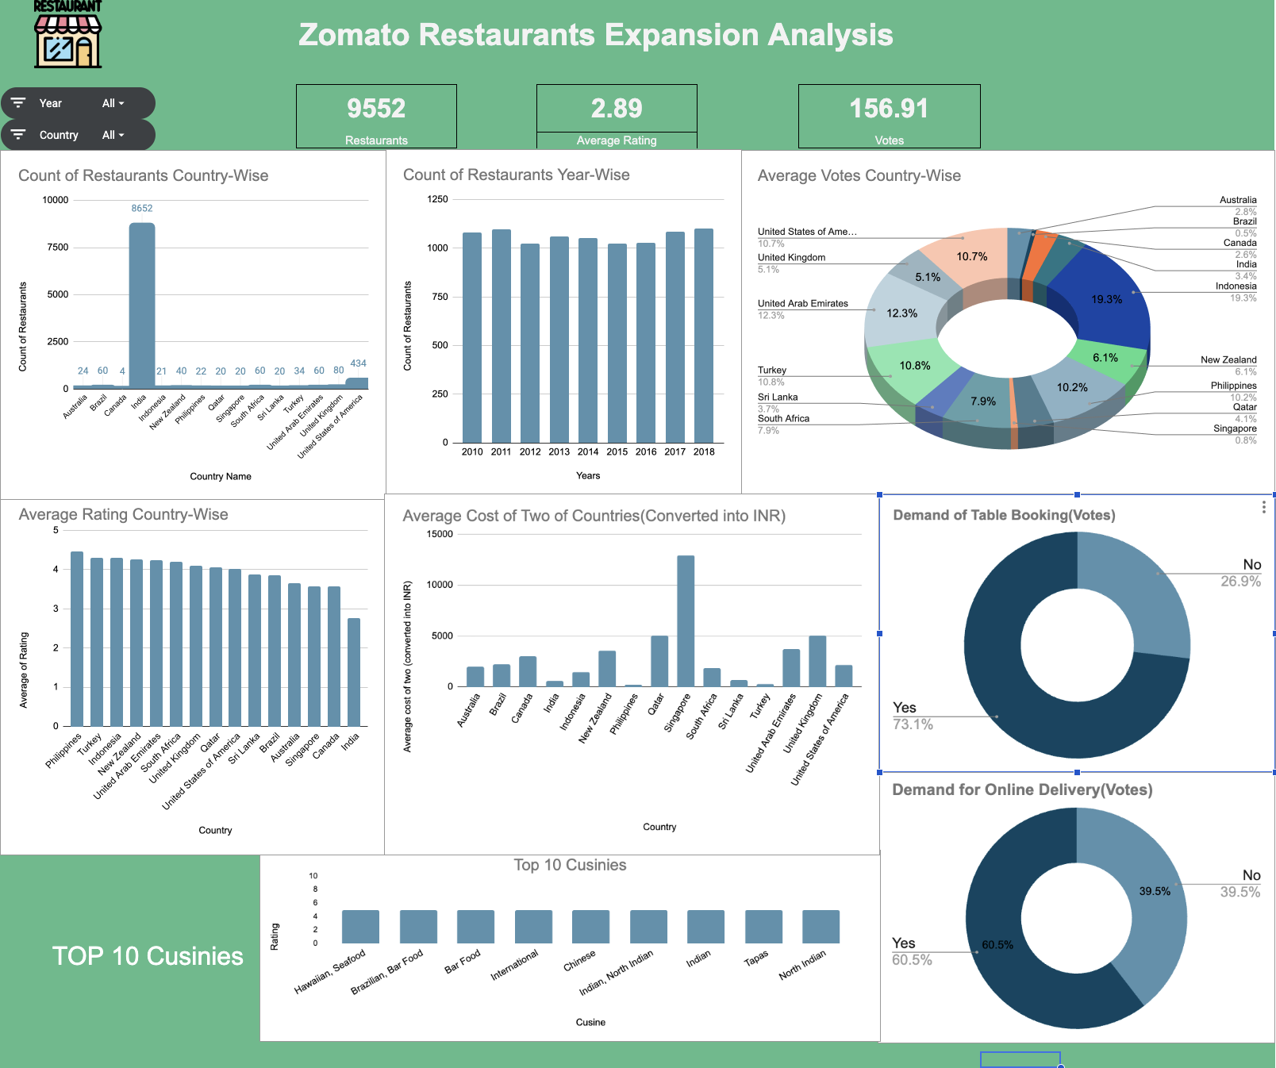
Dashboard and Visualizations
Primary Expansion: Focus on Philippines, Indonesia, and Turkey due to high ratings and low competition.
Service Integration: Implement online delivery and table booking to boost engagement.
Pricing Strategy: Target 2–3 price bracket for affordability and perceived quality.
Marketing Focus: Run campaigns in high-rating, low-vote cities like Quezon City to increase engagement.
Cuisine Selection: Prioritize high-performing cuisines such as Japanese, Italian, and American (up to 4.9 ratings).

Slide 20

Conclusion
Identified key locations to open the new restaurant
Found the pain points which cause the demand
Analyzed the impact of technology in demand generation
Zomato should prioritize expansion in the Philippines and Indonesia to maximize return on investment.
Customer engagement is strong in these regions, indicated by high activity levels, ratings, and votes.
A mid-range pricing strategy is recommended to effectively target the largest customer segment.
Zomato should emphasize digital-first service features to differentiate itself and improve user experience.

Slide 21
Reference
Zomato Data

